Slide 1
Keeping subscribers, growing the right markets
BIG DATA ANALYTICS · MANAGEMENT BRIEFING
A trusted data platform and churn model for a streaming subscription business
SHANGEETH VANNIYASINGAM 15139531 · 604-IT · Hypothetical case study built on Spotify-style synthetic data
Notes:
Opening (about 30 seconds). Introduce the case: a hypothetical Spotify-style subscription business. State that all data is synthetic. Preview the five parts: problem, data solution, analysis, recommendations, ethics. Total time budget is 15 minutes, about 1 to 1.5 minutes per slide.

Slide 2
The business problem and objective
Churn is unexplained
OBJECTIVE
Management cannot see why subscribers cancel.
Reduce churn and focus spend on the highest-value markets
Market value is unclear
Marketing spend is not tied to the markets that matter most.
Using one trusted, repeatable analytics platform.
Data is scattered
Several sources, manual reports, no trusted history when plans change.
Hypothetical case study · synthetic data
2
Notes:
About 1.5 minutes. Criterion 1: explain the challenge, the aim, and why it matters to the organisation. Three pains on the left lead to one objective on the right. Say how success is measured: a churn rate by plan and market, the behaviours that signal risk, and one data layer finance and marketing both trust.

Slide 3
Database design: a star schema
dimuser
dimtrack
plan, country, history (SCD2)
track name, artist link
FACT TABLE
factstream
one row per stream: user, track, date, listen duration
dimdate
dimartist
calendar attributes
artist details
Why relational: structured, joined data suits SQL and BI. SCD Type 2 keeps a row for every plan or country change.
Hypothetical case study · synthetic data
3
Notes:
About 1.5 minutes. Criterion 2. Show the star schema: one fact table of streams surrounded by user, track, date and artist dimensions. Justify relational (Azure SQL as source, Delta tables in the lake) over NoSQL: the data is structured and analysed with joins. Explain SCD Type 2 on dimuser using __START_AT and __END_AT, so history is never overwritten. Mention normalisation: dimensions hold each attribute once. Point to the schema and SQL in the appendix.

Slide 4

Big data architecture: bronze, silver, gold
Data Factory
Silver
Azure SQL
Bronze
Gold
ML + charts
source system
incremental load
raw files
cleaned, Autoloader
star schema
decisions
Incremental: a watermark file means each run loads only new rows.
Metadata-driven: Jinja templates generate the gold SQL, so adding a table is configuration, not new code.
Hypothetical case study · synthetic data
4
Notes:
About 1.5 minutes. Criterion 3. Walk left to right: Azure SQL is the source, Azure Data Factory copies only new rows using a watermark (cdc.json), raw files land in the bronze layer of Azure Data Lake Storage, Databricks Autoloader cleans them into silver, and gold holds the business-ready star schema. The ML model and charts read from gold. Note honestly that I ran Autoloader in batch mode (availableNow trigger); it is streaming-ready.

Slide 5
Why these tools: enterprise needs
Tool | Why chosen | Need met
Data Factory | Scheduled incremental loads, no code | Automation
Data Lake Gen2 | Cheap, scalable file storage | Scalability
Delta Lake | Reliable tables, MERGE for history | Reliability
Autoloader | Picks up new files automatically | Near real time
Spark on Databricks | Distributed processing | Growth in volume
Trend: the lakehouse puts reporting and machine learning on one platform instead of two.
Hypothetical case study · synthetic data
5
Notes:
About 1 minute. Criterion 3 continued: justify each tool against enterprise requirements (scalability, flexibility, availability, real-time). Be honest about trade-offs: serverless Databricks has limits, and I could not complete a Delta Live Tables pipeline because of a metastore configuration, so SCD2 was built with Delta MERGE instead. Mention the lakehouse trend as the current direction in big data. Add one real academic or industry source in the report for this claim.

Slide 6
Analysis: predicting who will churn
1
2
3
Define churn
Build features
Fit and test
No streams after a cutoff date.
Plan, tenure, streams, listening time, tracks, days inactive. Only data before the cutoff.
Logistic regression, 75/25 split and 5-fold cross-validation.
Why logistic regression: simple, fast on small data, and each coefficient can be explained to managers. K-means segments are a second view.
Hypothetical case study · synthetic data
6
Notes:
About 1.5 minutes. Criterion 4. Explain the three steps. Stress that the label comes from future behaviour and the features from past behaviour, so the model predicts rather than repeats the label. There were no cancellation dates in the data, so inactivity is a proxy for churn; say so. Justify logistic regression over complex models: explainability to non-technical managers. Mention class_weight=balanced and why accuracy alone is misleading.

Slide 7
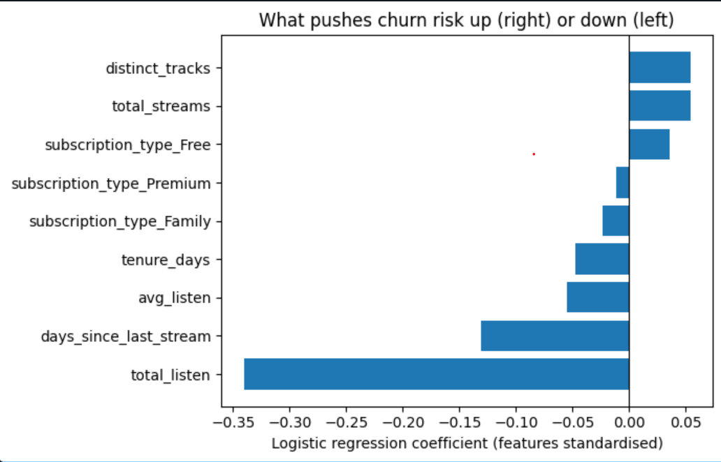
Model results: little signal in the data
Test ROC AUC
0.45
5-fold cross-validation AUC
0.49 ± 0.06
Recall for churned users
53%
Insight: An AUC below 0.5 means the model is no better than chance. On this synthetic data, behaviour does not predict who leaves.
Hypothetical case study · synthetic data
7
Notes:
About 1.5 minutes. Criterion 4 continued. Replace the bracketed placeholders with your own numbers from the notebook output (test AUC, cross-validation mean and spread, recall for class 1) and paste the coefficient chart over the dashed box. Interpret in plain words: an AUC near 0.5 means the features carry little signal, which is a legitimate finding on synthetic data. Mention the majority-class baseline you printed.

Slide 8
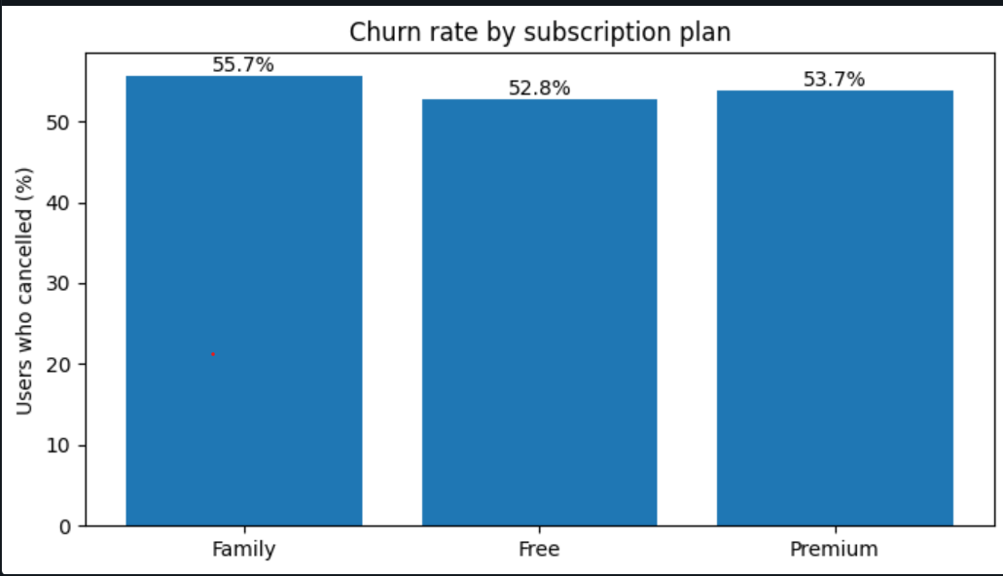
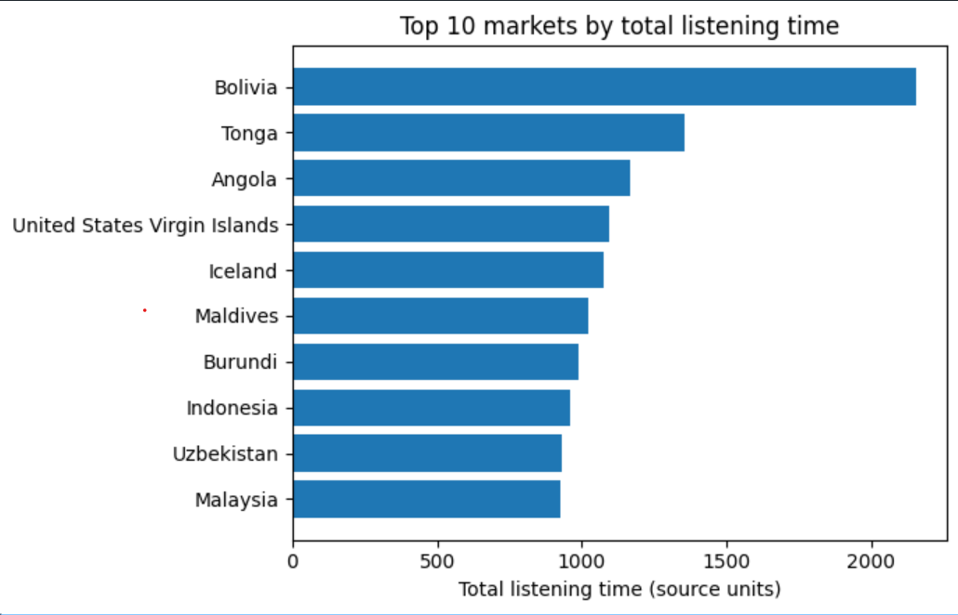
Executive view: churn by plan and market
Churn rate by subscription plan
Top 10 markets by listening time
Family is highest at 55.7%, but all three plans sit within 3 points (52.8% to 55.7%).
Bolivia leads on listening time, ahead of Tonga and Angola. Units to be confirmed.
Hypothetical case study · synthetic data
8
Notes:
About 1.5 minutes. Criterion 5. Paste the two section 4 charts over the dashed boxes: churn rate by plan and top 10 markets by total listening time (confirm the units first). One sentence of insight under each, written from your own output. Justify the visual choices: bar charts because the comparison is between categories and executives read them fastest; a single message per chart; no decoration. Retained versus churned engagement and the monthly trend chart can go in the appendix.

Slide 9
Findings and recommendations
1
Collect real cancellation data first
Record cancellations, so churn is measured, not inferred.
2
Put marketing budget behind top markets
Start with Bolivia, Tonga and Angola, once units are confirmed.
3
Make the gold layer the single source of truth
Refresh daily, then retest the model on real data.
Hypothetical case study · synthetic data
9
Notes:
About 1.5 minutes. Criterion 6. Each recommendation must link back to the objective (reduce churn, focus on high-value markets) and to evidence from your charts. Fill the bracketed values from your own results. Do not claim a financial saving unless you have calculated one; if you estimate one, state the assumptions.

Slide 10
Legal and ethical considerations
Privacy and UK GDPR
Security
Collect only what is needed. Pseudonymise user names. State the lawful basis.
Role-based access in Azure and Unity Catalog. Least privilege for every user.
Fairness
Responsible use
No sensitive attributes in the model. Country is used in charts only.
An explainable model, with a person reviewing offers before they go out.
Hypothetical case study · synthetic data
10
Notes:
About 1 minute. Criterion 7. Cover privacy and data protection (UK GDPR principles: lawfulness, purpose limitation, data minimisation, storage limitation, security), ethics (fairness, transparency, avoiding automated decisions that harm customers), and professional responsibility. Say that this project used synthetic data, so no real personal data was processed, and explain what you would do with real data (a data protection impact assessment, retention limits). Cite the ICO guidance or the legislation itself in the report, only after opening it.

Slide 11
Summary, limitations and next steps
WHAT WE BUILT
LIMITATIONS
NEXT STEPS
One governed pipeline from SQL source to gold tables, with history kept.
Synthetic data and a small sample.
Use real cancellation dates.
Churn is inferred from inactivity, not cancellations.
Add real-time scoring with streaming.
A churn model and executive charts that answer the objective.
Batch scoring only, no real-time model.
Track whether offers reduce churn.
Hypothetical case study · synthetic data
11
Notes:
About 1 minute. Close with the answer to the objective, then limitations stated plainly (this is critical evaluation and earns credit), then next steps. End by inviting questions. Keep the last 30 seconds spare for time management.

